Slide 1
Project work

Slide 2
Agenda
What does the project work look like
Steps of the project work
Planning a project: Project outline
How should I proceed with my project?
How do I manage a project?
Conclusion
Notes:
Here you can introduce the students to the topic of the presentation.
The aim is to provide an overview of what project work is about, how to proceed and how to create a project outline.

Slide 3
Welcome and arrival
Notes:
This is a blank slide that you can use to do an introductory activating activity with your group (if you start the session with this presentation).

Slide 4

What does the project work look like?
The aim of the project seminar in the "Responsibility" module is to immerse students in the world of science, explore the rules and experience self-organized research-based learning (Michelsen et al., 2018).
The work produced includes the project report and a presentation during the conference week (Michelsen et al., 2018).
The project is carried out in groups and is divided into 2 parts:
Detailed information on the responsibility module can be found in the video and presentation impulses in the Moodle course under Excursus: "The project work in the
module".
Part A - Planning a project
Part B - Implementation and evaluation of a project
Notes:
On this slide, we present the research project to be completed in the "Responsibility" module. We recommend that tutors read the document "Guidelines for project work" in the module "Responsibility" so that they can get an idea of what is required of students in this assignment.
Tip: If you took part in the Leuphana Conference Week yourself, we encourage you to share your experiences with the students.

Slide 5
Steps of the project work
You can use MURAL to create mind maps online!
Step 1 - Get a picture
Step 3: Thesis and hypothesis
Literature research, personal interests and current academic discussions.
Mind maps or other visualization strategies can help to identify connections between different topics.
After reviewing the literature, one will develop an assumption about the direction of the answer to the research question (Michelsen et al., 2018).
One possibility now is to develop hypotheses that you will try out during your project.
Step 2: From the idea to the research question
Further tips on
formulating your
research question can be found in the "Guidelines for project work in the Responsibility module"
at Moodle.
The review research question is at the heart of the project.
Notes:
On this and the following pages, we have compiled some valuable tips for writing your project report. Tutors are encouraged to share their own experiences and possible tips with students.
Tip: You can explore the MURAL tool with the students in the session.

Slide 6
Steps of the project work
Step 4: Methods and work plan
Step 6: Present and interpret results
In this phase, a research design is to be developed that takes into account the organizational, temporal and contextual requirements (Michelsen et al., 2018).
Once you have your results, you need to sort them in a way that makes sense for the investigation.
Step 7: An answer to the research question and critical reflection.
Step 5: Carrying out the examination
It is important to support the validity and reliability of your work.
In this phase, you should summarize your results in a conclusion (Michelsen et al., 2018).
Notes:
Continuation of the previous slide.
Please refer to the document "Guidelines for project work in the "Responsibility„ Moodle course and its appendix.

Slide 7
Planning a project: Project sketch
The project sketch summarizes the most important points that should be clarified at the beginning of a scientific project.
It provides an overview of the current status of the project (see: Moodle Responsibility – Materials for project work):
(i) What question do you want to answer with your project;
(ii) How you plan to achieve this goal, how you plan to answer the question(s), and;
(iii) What concrete results do you expect to achieve?
Creating a project outline is an anticipation of the structure of your project.
Notes:
One of the tasks of the students before submitting the final thesis of the module is to create a project outline of their research work. This allows the lecturers to check whether the project is going in the "right" direction. The lecturer's opinion is more important in this context than the project outline template.
The project outline summarizes the most important points that should be clarified at the beginning of a scientific project.
It is basically an anticipation of the structure of the project. There are some similarities with the synopsis.
On the Responsibility Moodle course, all the important documents for writing the project paper are listed at the top of the page.

Slide 8
Planning a project: Project sketch
You can find more information in the template for the project sketch on Moodle
Background and topic
Procedure
Research question
Brief description of why the planned work is topical and relevant
Try to state your guiding research question as clearly and precisely as possible in one sentence
formulate.
Describe clearly how you want to proceed in order to answer your research question.
Notes:
Here is a diagram with the most important points of a project outline as highlighted in the document provided by Leuphana Semester.
We suggest that tutors take a look at the document before the session.
Note that much of the content of a project outline will be included in the final version of a scientific paper.
Remind students that the purpose of a project outline is to provide an initial structure for their research project.
Give students the opportunity to ask questions about the structure of a project outline.

Slide 9
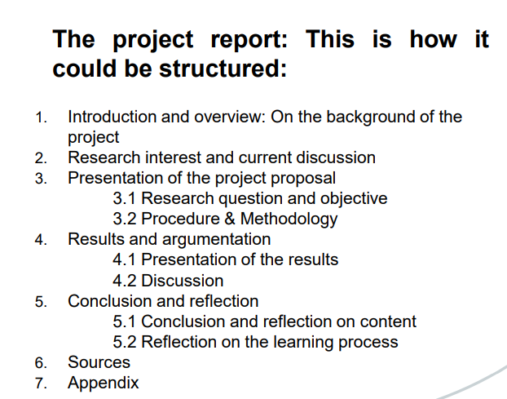
How should I proceed with my project?
Proposed structure
Notes:
On this slide you will find some tips on how students can organize themselves to work as a group on a project. It is important to note that more detailed tips are part of the content of the specific tutorials for group work, time organization, etc.
Suggestion: Show the students the cascade model developed by Dr. Dagmar Knorr: https://www.leuphana.de/fileadmin/user_upload/sonstige_einrichtungen/Schreibzentrum/Knorr_2018_Cascade-model-academic-text-production.pdf

Slide 10
How do I manage a project?
Goal setting and communication are essential.
Project management tools to organize your group activities and divide tasks.
  Here you will find a list of tools.
  Use of collaborative writing tools or cloud files that can be easily accessed.
  An illustrative example of how scientific writing works is the cascade model developed by Dr. Dagmar Knorr.
Notes:
This slide is not about the project sketch, but about the project report that is to be written for the "Responsibility" module.
In the document "Slides Impulse 03" in the Moodle of the module "Responsibility" you will find some information about the project report that the students have to write.
This document also contains an example of the structure of the project report (see image in the slide).

Slide 11
Sources
Michelsen, G. (Ed.). (2018). Guideline for the project work in the module "sustainability and responsibility." Leuphana University.
Writing in German - SWC Resources
Dr Dagmar Knorr Cascade model: https://www.leuphana.de/fileadmin/user_upload/sonstige_einrichtungen/Schreibzentrum/Knorr_2018_Cascade-model-academic-text-production.pdf
All further information can be found on Moodle in the responsibility module
Notes:
- The documents from the SWC can no longer be found online (i.e. no longer accessible to students), but are stored in the materials on Moodle.

